Slide 1
Research Platform for Custom Memory Cube
Yu Zou
Vinayak Deshpande
Peter Harduvel
Dr. Herman Lam
Assoc. Professor of ECE
University of Florida

Slide 2
Outline
Review & overview
Notional CMC architecture
Performance measurements on Merlin board
Mapping notional CMC to Merlin board
Experiments & measurements
Non-overlapping memory access
Simple read & write ops, DRE ops
Overlapping memory access
Simple read & write ops, DRE ops
Simplified CMC-to-Merlin mapping
Application of simplified mapping to DRE option 2
Going forward
* DRE: Data rearrangement/reordering engine ** CMC Computational Memory Cube

Slide 3
Outline
Review & overview
Notional CMC architecture
Performance measurements on Merlin board
Mapping notional CMC to Merlin board
Experiments & measurements
Non-overlapping memory access
Simple read & write ops, DRE ops
Overlapping memory access
Simple read & write ops, DRE ops
Simplified CMC-to-Merlin mapping
Application of simplified mapping to DRE option 2
Going forward
* DRE: Data rearrangement/reordering engine ** CMC Computational Memory Cube

Slide 4
Notional CMC Architecture*
Based on Nair et al.* : an HMC with a user-programmable logic layer
A, B, C, D, and : performance-measurement points of interest
* Nair, R., et al. "Active Memory Cube: A processing-in-memory architecture for exascale systems.“ IBM Journal of Res. & Development 59.2/3 (2015): 17-1.

Slide 5
DRE* Prototype on CMC Architecture
VB3
VB2
VB3
VB1
View buffer (VB) can be set up on host (design option 1), inside the HMC (design option 2) or inside CMC logic (design option 3)
* DRE: Data Reordering/Rearrangement Engine Lawrence Livermore Nat. Labs

Slide 6
Performance Measurement on Merlin Board
CMC platform on Merlin board
*
Instrumented Merlin infrastructure with hardware performance monitors
A’, B’, C’, D’, M1, M2, M3, M4, M5, and E’
Progress: Able to measure all listed parameters except:
M4, M5: Exploring with help from Convey
E’: Exploring with help with Micron under NDA
VB*: View Buffer

Slide 7
Mapping Notional CMC onto Merlin Board
Merlin board
Case study: model of a notional CMC
Simplifying assumption:
For this model, this part of CMC is assumed to have an HMC architecture

Slide 8
Model of CMC-to-Merlin Mapping
Model of notional CMC
CMC platform on Merlin board
Latency A = ctrl signal transfer time B + latency C + result transfer time B
Ctrl signal transfer time B : time to transfer control signals between host and CMC
Data transfer time B: time for host access to obtain result (e.g., transfer from view buffer)
Latency C = delay TSV* + latency C’ – delay D’minusE’
Delay D’minusE’ = latency D’ – latency E’
* delay TSV= between DRE core and switch, time to transfer a request +
time to transfer response of that request
Latency: round-trip delay from input into a point in the system to desired outcome

Slide 9
Outline
Review & overview
Notional CMC architecture
Performance measurements on Merlin board
Mapping notional CMC to Merlin board
Experiments & measurements
Non-overlapping memory access
Simple read & write ops, DRE ops
Overlapping memory access
Simple read & write ops, DRE ops
Simplified CMC-to-Merlin mapping
Application of simplified mapping to DRE option 2
Going forward
* DRE: Data rearrangement/reordering engine ** CMC Computational Memory Cube

Slide 10
Review of DRE setup, fill, drain
void setup(value_pointer refp, index_pointer indexp, value_pointer sp)
{
ref_base = refp;
idx_base = indexp;
scratchpad = sp;
}
void fill() {
for (size_t i = 0; i < scratchpad.length(); i++) {
scratchpad[i] = ref_base[idx_base[i]];
}
}
void drain() {
for (size_t i = 0; i < scratchpad.length(); i++) {
ref_base[idx_base[i]] = scratchpad[i];
}
}

Slide 11
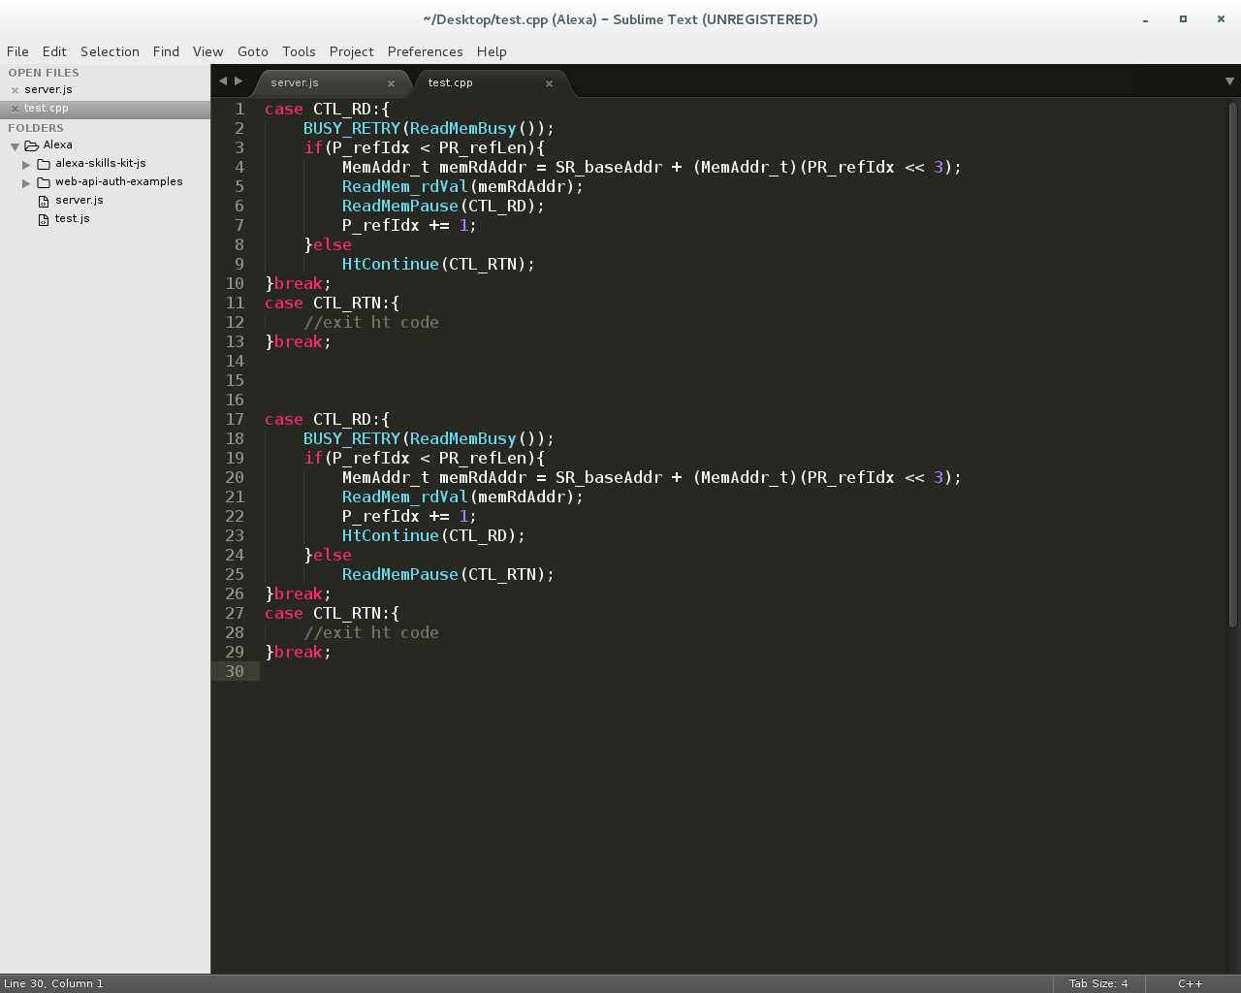
Memory Access on Merlin Board
Non-overlapping memory accesses
Overlapping memory accesses
Wait for data return before issuing next memory request
Send next memory request immediately after sending previous one
Barrier synchronization to guarantee all responses are returned before exiting code

Slide 12
Non-overlapping Memory Access: read/write ops
Observation: M1 > M2 > M3 (> M4 > M5 > E’)

Slide 13
Non-overlapping Memory Access
Measured performance: simple read/write (µs) (Averaged over 100,000 iterations)
Oper. | A’ (µs) | C’ | D’ | M1 | M2 | M3
Read | 1095.6 | 1.03 | 1.006 | 0.923 | 0.725 | 0.519
Write | 1104.0 | 1.071 | 1.011 | 0.991 | 0.793 | 0.577
Measured performance: Vector Addition in ms (100,000 iterations of 2 reads & 1 write)
A’ (ms) | C’ | D’ | M1 | M2 | M3
282.55 | 281.72 | 278.72 | 258.96 | 199.68 | 151.31
Measured performance: SpMV – DRE app in seconds (2²⁴ X 2²⁴ matrix)
A’ (s) | C’ | D’ | M1 | M2 | M3
1658.67 | 1580.14 | 1559.65 | 1460.57 | 1122.42 | 839.84
Observation consistent with expectation: M1 > M2 > M3 (> M4 > M5 > E’)
Notes:
Add slide before this to have graphs similar to Slide 13 for various # of iterations.

Slide 14
Overlapping Memory Access: read/write ops
Observation: M1, M2, M3, (M4, M5, E’) have no significant difference

Slide 15
Overlapping Memory Access: DRE ops
Observation: M1, M2, M3, (M4, M5, E’) again have no significant difference
For overlapping memory access, discrepancy between M1, M2, M3, (M4, M5, E’) is hidden by “pipeline effect”
Thus, a simplified CMC mapping can be used

Slide 16
Outline
Review & overview
Notional CMC architecture
Performance measurements on Merlin board
Mapping notional CMC to Merlin board
Experiments & measurements
Non-overlapping memory access
Simple read & write ops, DRE ops
Overlapping memory access
Simple read & write ops, DRE ops
Simplified CMC-to-Merlin mapping
Application of simplified mapping to DRE option 2
Going forward
* DRE: Data rearrangement/reordering engine ** CMC Computational Memory Cube

Slide 17
Simplified Notional CMC Modeling
For pipelined overlapping memory operations, estimate:
M1 = M2 = M3 = M4 = M5 = E’
Model of notional CMC
CMC platform on Merlin board
Latency A = ctrl signal transfer time B + latency C + result transfer time B
Ctrl signal transfer time B : time to transfer control signals between host and CMC
Data transfer time B: time for host access to obtain result (e.g., transfer from view buffer)
Latency C = latency C’ – delay D’minusE’ + delay TSV*
Delay D’minusE’ = latency D’ – latency E’
Latency: round-trip delay from input into a point in the system to desired outcome

Slide 18
Simplified Notional CMC Modeling
For pipelined overlapping memory operations, estimate:
M1 = M2 = M3 = M4 = M5 = E’
Model of notional CMC
CMC platform on Merlin board
Latency A = ctrl signal transfer time B + latency C + result transfer time B
Ctrl signal transfer time B : time to transfer control signals between host and CMC
Data transfer time B: time for host access to obtain result (e.g., transfer from view buffer)
Latency C = latency C’ + delay TSV*
Latency: round-trip delay from input into a point in the system to desired outcome

Slide 19
Outline
Review & overview
Notional CMC architecture
Performance measurements on Merlin board
Mapping notional CMC to Merlin board
Experiments & measurements
Non-overlapping memory access
Simple read & write ops, DRE ops
Overlapping memory access
Simple read & write ops, DRE ops
Simplified CMC-to-Merlin mapping
Application of simplified mapping to DRE option 2
Going forward
* DRE: Data rearrangement/reordering engine ** CMC Computational Memory Cube

Slide 20
Scope and Parameter Definition
Current scope: 1 link, 1 CMC core architecture
Will scale and parameterize in future (n links, m core)
1 CMC Core
1 link
Link parameters:
BW_{link}: Bandwidth of host-CMC interface (bit/s)
W_{host-cmc}: # of bits of host-CMC message (request + response) (bit)
Data: W_{host-cmc}(data)
Ctrl: W_{host-cmc}(ctrl)
TSV parameters
BW_{TSV}: Bandwidth of TSV connection (bit/s)
W_{core-sw}: # of bits of core-switch message (request + response) (bit)

Slide 21
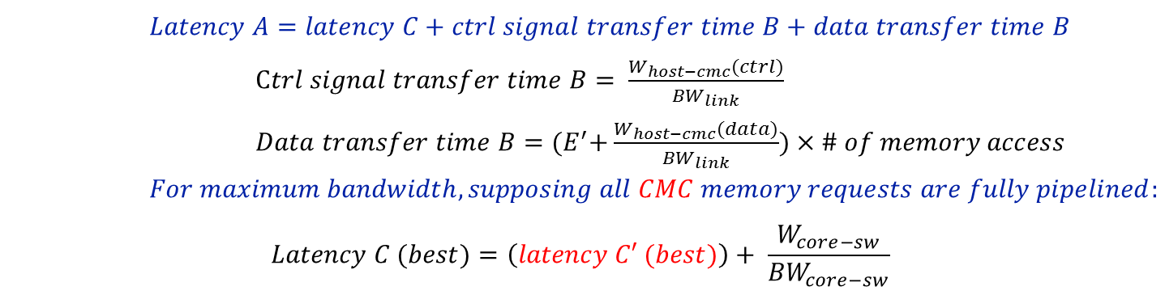
CMC Best-case Performance (Design Op2, 1 link, 1 CMC core)
Model of notional CMC
CMC platform on Merlin board
**
$$Latency A=latency C+ctrl signal transfer time B+data transfer time B$$
$Ctrl signal transfer time B= \frac{W_{host−cmc}(ctrl)}{{BW}_{link}}$
$Data transfer time B={(E}^{′}+\frac{W_{host−cmc}(data)}{{BW}_{link}})×\# of memory access$
$$For maximum bandwidth, supposing all CMC memory requests are fully pipelined:$$
$$Latency C (best)=\left(latency C′ (best)\right)+ \frac{W_{core−sw}}{{BW}_{core−sw}}$$
However, memory accesses in Merlin board cannot be fully pipelined

Slide 22
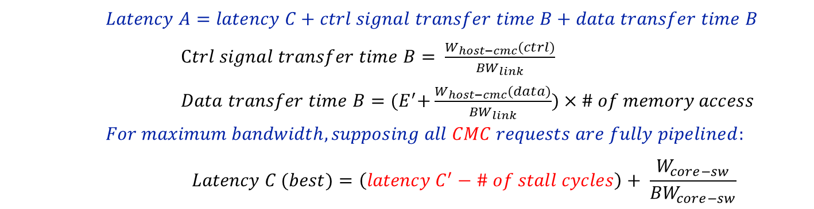
CMC Best-case Performance (Design Op2, 1 link, 1 CMC core)
Model of notional CMC
CMC platform on Merlin board
$$Latency A=latency C+ctrl signal transfer time B+data transfer time B$$
$Ctrl signal transfer time B= \frac{W_{host−cmc}(ctrl)}{{BW}_{link}}$
$Data transfer time B={(E}^{′}+\frac{W_{host−cmc}(data)}{{BW}_{link}})×\# of memory access$
$$For maximum bandwidth, supposing all CMC requests are fully pipelined:$$
$$Latency C (best)=\left(latency C^{′}−\# of stall cycles\right)+ \frac{W_{core−sw}}{{BW}_{core−sw}}$$
# of stall cycles can be measured in the Merlin board infrastructure Verilog code

Slide 23
Case Study Result for Random Access App. (progress)
Determined CMC best-case performance
Determined Latency A for DRE random access (fill & drain)
Derived from mapping to Merlin board
Included Merlin-board stalls
Problem: Fill and Drain expected to have same performance
Fill and drain correct at points M1, M2, M3
Problem may be measurement at C’
Currently measuring Fill and Drain at C’
Notes:
Change Y axis to Latency A
Define X axis (31 what?)
Correct “Randa” to “Randum”

Slide 24
Going Forward
Creating user-friendly CMC API
Share code and lessons with LPS
Visit LPS at some time
Continue researching on CMC modelling for multiple links multiple CMC cores
Study sorting and bloom filter on CMC

Slide 25
Going Forward
F1
Platform development
Complete development & instrumentation of CMC platform
Develop library for customization of notional CMC architecture under study
Create user-friendly CMC API
Explore CMC apps using HT
Case studies to explore
Notional CMC architectures
CMC apps, including:
Data Reordering/Rearrangement Engine, sorting algorithms, bloom filter
Lessons learned, including:
Characteristics of CMC-amenable apps
How to re-factor algorithms to become CMC-amenable
Share code and lessons with LPS
Visit LPS

